Slide 1

EMS
Employee Management System
Presented by:
Team Vikings

Slide 2
Group Members and Roles
Vamsi Paturi : Front End Developer
Venkata Madhav Thota : Database Engineer/ Quality Analyst
Dilip Kumar Vavilapalli : GUI Designer
Vaishnavi Prakash Rasane : Backend Developer / Document Designer
Professor: Erik Fredericks

Slide 3
Employee management system is a software, that helps your employees to give their best efforts every day to achieve the goals of your organization. It guides and manages employees efforts in the right direction. It also securely stores and manages personal and other work-related details for your employees.
What is Employee Management System?

Slide 4
Features:
HR/Admin and Employee login
Upload Employee onboarding documents
Employee Work History Record
Employees List and their record
Salary Management
Attendance Management

Slide 5
Tech Stack:
Angular JS
It is used for front-end web application development framework using type script for development
Amazon S3
Using to save documents on the server
Node Js
Used node.js as a backend server with mongoDB to store data in the database

Slide 6
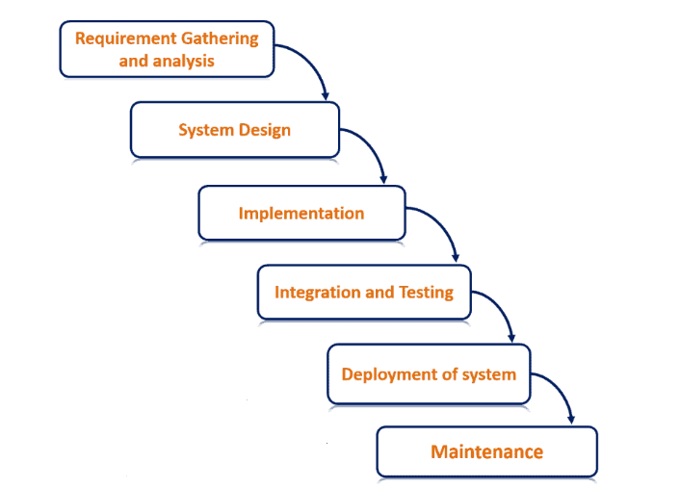
Project Lifecycle: Waterfall Model

Slide 7
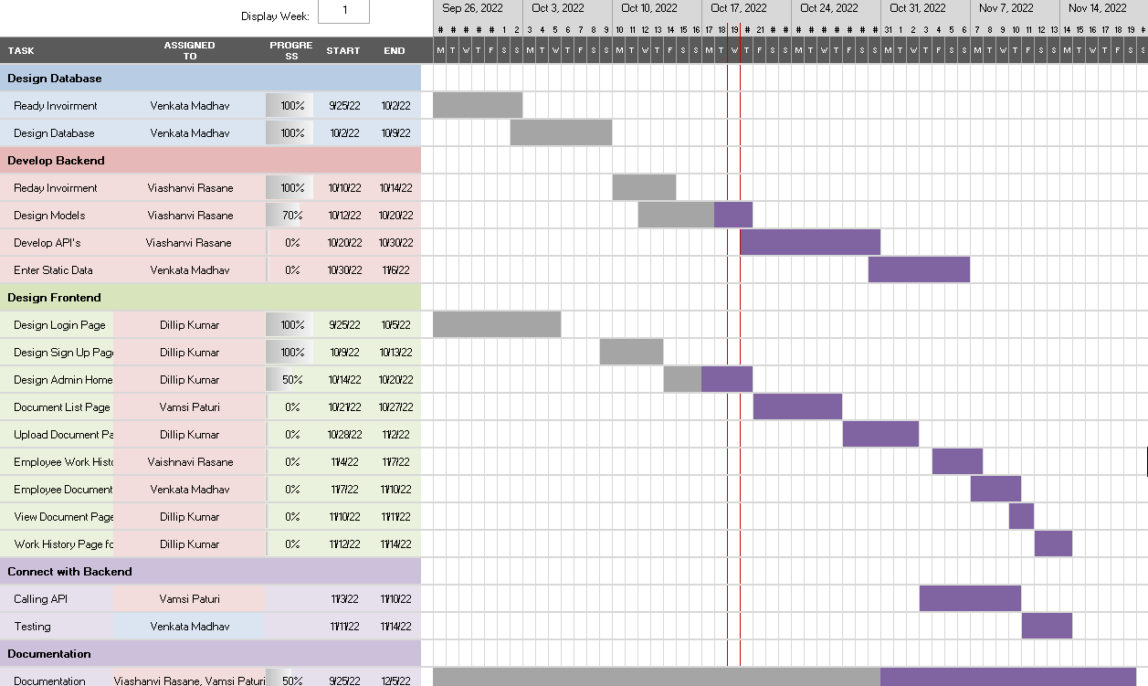
Gantt Chart

Slide 8
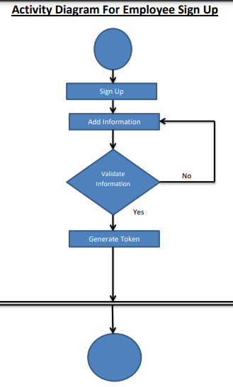
Activity Diagram

Slide 9
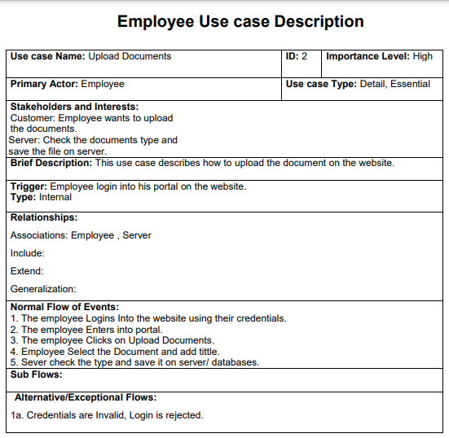
Use-case Description

Slide 10
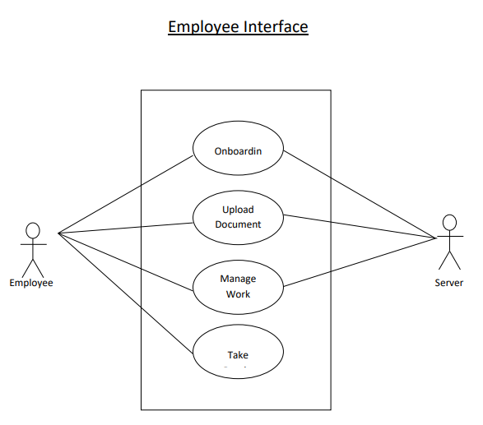
Use Case diagram for Employee

Slide 11
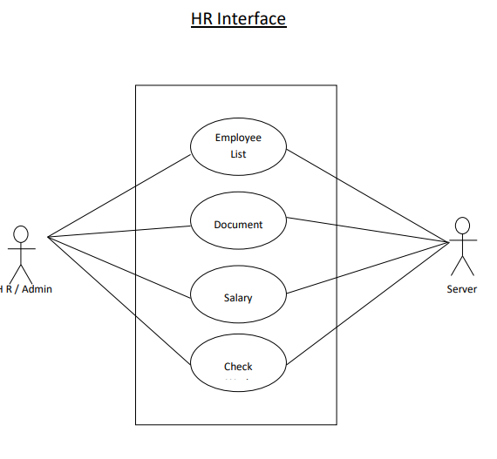
Use Case diagram for HR

Slide 12
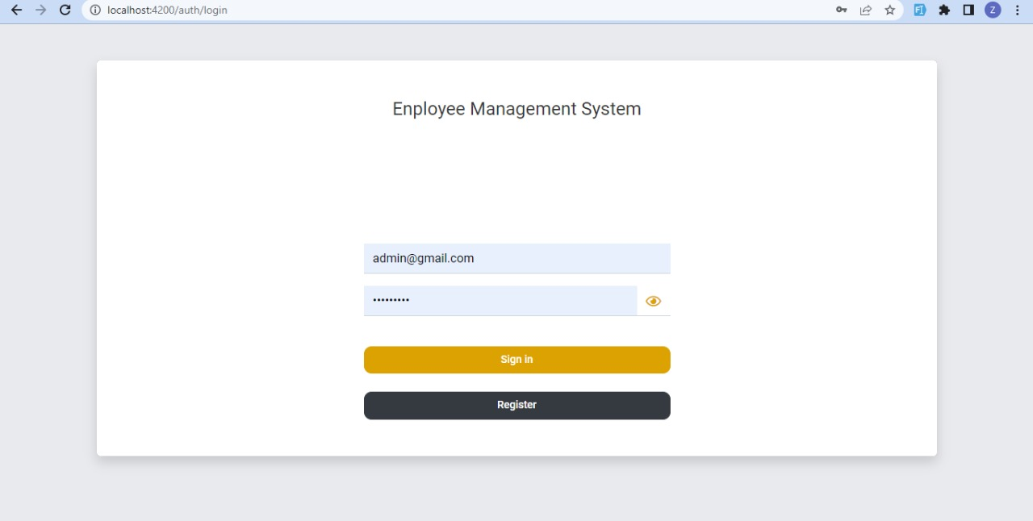
Developed User Interface:
Login Screen

Slide 13
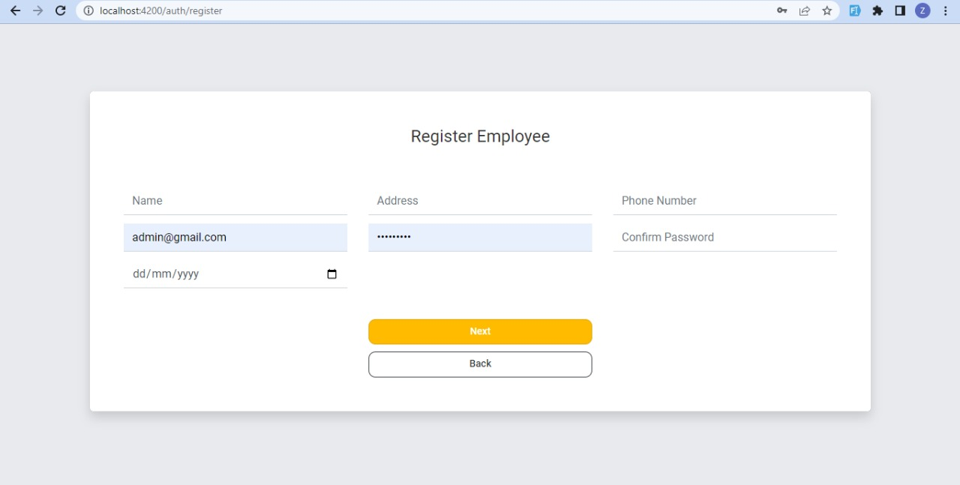
Developed User Interface:
Register page

Slide 14
Thank you!

